Slide 1
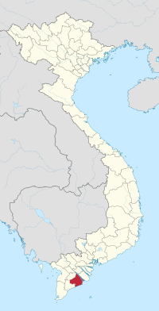
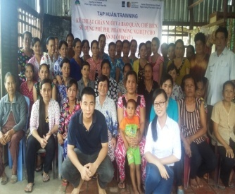
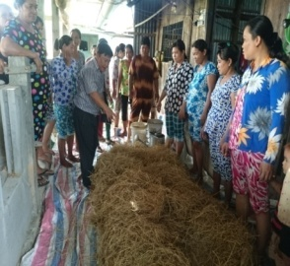
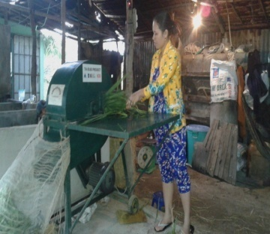
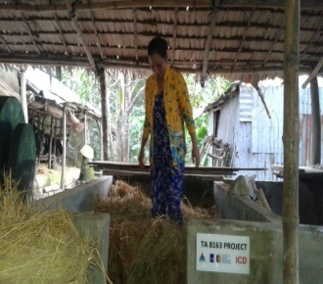
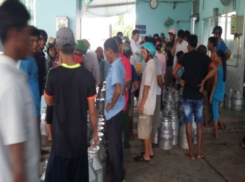
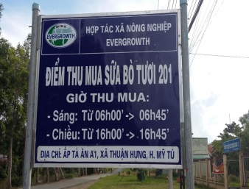
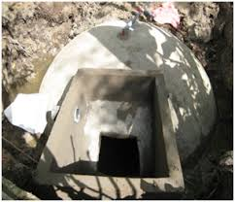
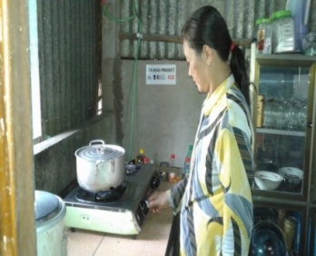
Training techniques of usage and processing of Agricultural by-products for household dairy production to Khmer women in SocTrang province
Dau Van Hai, Nguyen Thi Hong Trinh- Institute of Animal Sciences for Southern Vietnam
Objective :Improving Khmer women’s role and knowledge about dairy production Increasing profits from dairy husbandry through processing and storage local available agricultural by-products to feed dairy cattle. Developing a model of dairy cow production, using agricultural by products and contributing to reduction of greenhouse gas emissions. | Contents: Training about management and techniques of usage and processing of agricultural by-products to 120 Khmer ethnic women. Establishing 3 pilots to instruct to targeted group (and 3 control pilots) using agricultural by- products as dairy feed
Results
Results:
Soc Trang Province
Training dairy production techniques
Processing, storage & using local agricultural by-products
Table 1: Feed intake
Item | Pilot | Control
Concentrate (kg/head/day) | 5.83 | 5.50
Fresh grass (kg/head/day) | 37.00 | 35.00
Urea treated rice straw (kg/head/day) | 5.00 | 0.00
Rice straw (kg/head/day) | 0.00 | 3.00
Cow weight | 456.33 | 444.97
Strengthening market access for dairy products
Table 2: Milk yield and reproductive ability and benefit
Item | Pilot | Control
Number of milking cows (3cows/pilot x 3 pilots=9cows) | 9 | 9
Milk yield (kg/head/day) | 13.93 | 11.80
Following estrus after calving (day) | 108.00 | 154.67
Benefit(VND/cow/day) | 102,573 | 86,300
Reducing environment pollution, GHG
Table 3: Up scaling
Item | Before | The end of project | After
Percentage of dairy farms preserved straw and agricultural by-products | 39.0 | 90.0 | >95.0
Percentage of dairy farms applied urea treated rice straw and silaged agricultural by-products technique | 0 | 30.0 | 80.0
Number of households used grass chop machine | 0 | 11 | 22
Number of households used biogas system | 8 | 196 | 200

